Slide 1

serene
FOUR MONTH ROADMAP

Slide 2

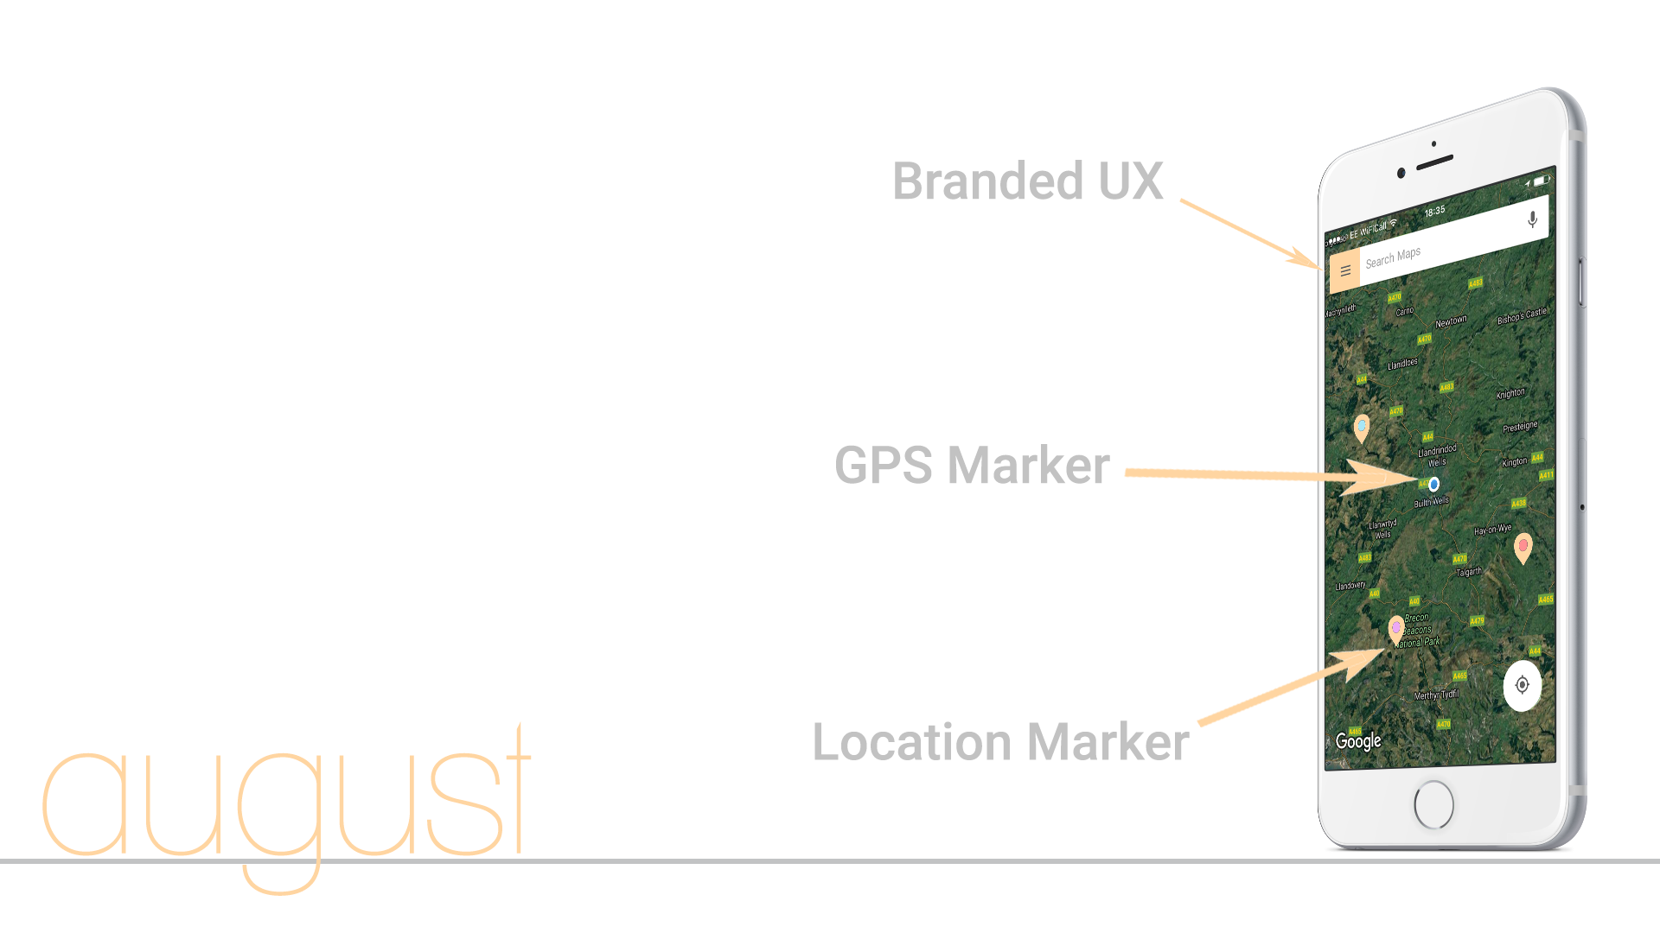
Aims and objectives…
Begin Canopy Program;
Launched MVP as a Progressive Web App Users, which includes:
Search location in address bar;
Ability to see & add markers to a branded map-based interface;
Shows users GPS location;
Create user account.
Aim to have articles in print with well-established cannabis media outlets;
8,000-10,000 followers on Instagram;
500 subscribers to mailing list;
Private BETA launch (100 users).

Slide 3
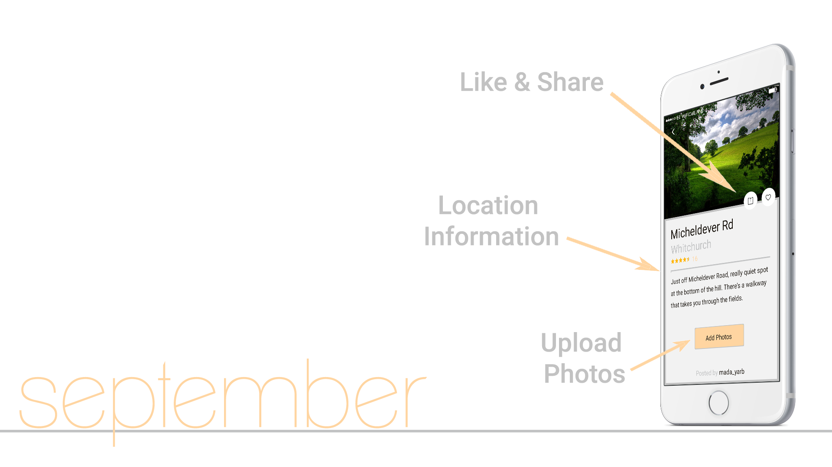
Aims and objectives…
Product updates include:
Ability to click into locations;
Upload photos;
Like & share the location.
Travel to the UK for WeWork Creator awards (confirmation in August);
Further investment in the form of a convertible note from Canopy;
10,000-20,000 followers on Instagram;
Physical marketing in Boulder/CO;
60-75% BETA users active & engaged;
Increased press coverage;
Run a ‘free beer and pizza’ event.

Slide 4
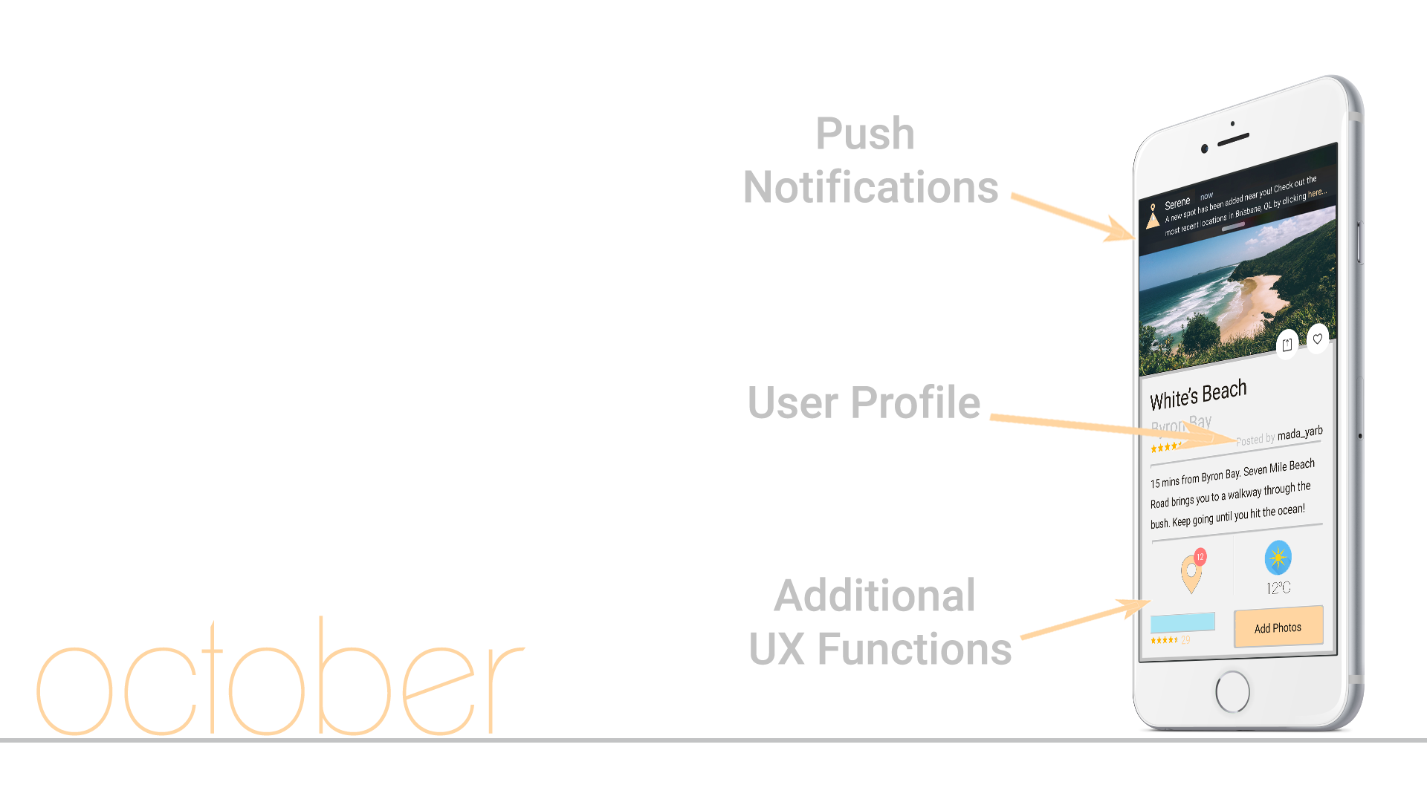
Aims and objectives…
Product updates include:
Push notifications to ‘check in’;
Weather info for locations;
Use ’like’ data to show top spots;
Ability to differentiate spots via flags.
Public BETA launch (1,000 registered users);
25,000+ followers on Instagram;
First significant partnerships;
Boulder/CO dispensaries linked to app via third party apps;
Investor ready.

Slide 5
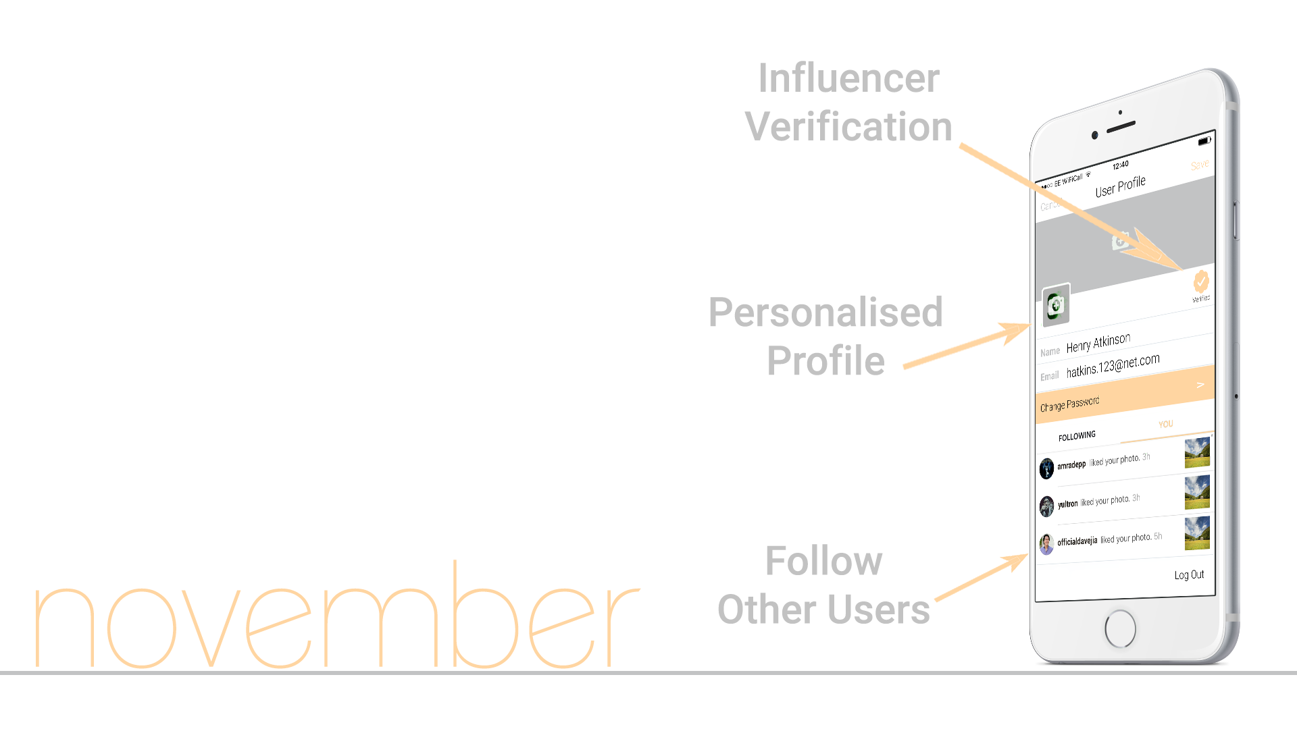
Aims and objectives…
Product updates include:
Personalise user profile;
Ability to follow other users;
Feed of updates on your locations;
“Following” feed to see other users locations.
5,000 registered users;
Continued work on developing partnerships;
Begin working towards partnership/sponsorship with Leafly – pull data from nearby dispensaries to Serene users;
$eries A.

